Slide 1

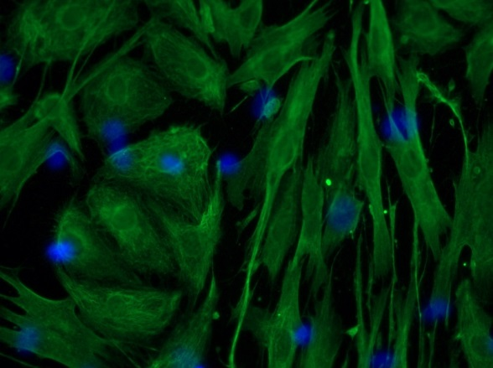
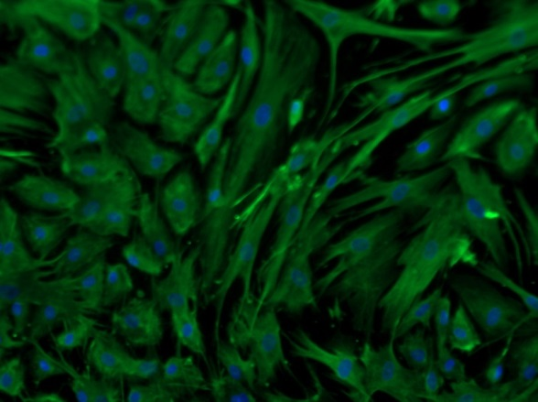
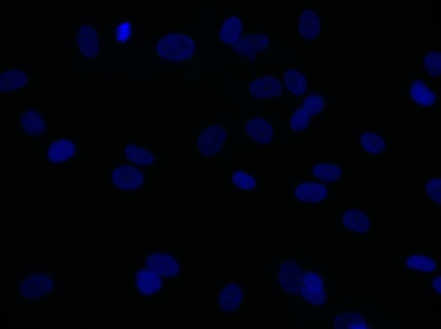
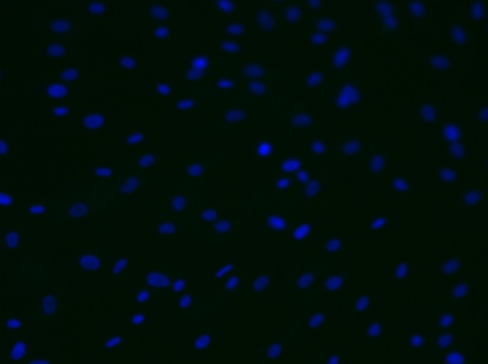
ReliaTech GmbH
Mouse anti-human VEGF-A #7G7
mouse anti-human VEGF-A (400X)
mouse anti-human VEGF-A (200X)
a-mouse ALEXA (400X)
a-mouse ALEXA (200X)
Immunofluorescence staining of VEGF-A in a mixture of primary human dermal lymphatic endothelial cells (HDLEC) and human dermal normal fibroblasts with monoclonal mouse anti-human VEGF-A #7G7 [Cat# 101-M58]. The cells were pretreated with 0,1% Triton X100. Control with goat anti-mouse ALEXA Flour 488 [Dianova], 1:600).
[IF_LECNH1406-01; 101-M58 (10µg/ml); 400X/200X]
http://www.reliatech.de / info@reliatech.de

